Slide 1
RELION in 2D
By Arunabh Ghosh

Slide 2
The work accomplished this week
Implemented the projection and the back projection operation exclusively in the Fourier domain and improved the results with smooth interpolation.
Instead of assigning an optimal orientation to each projection, probability-weighted integrals over all possible orientations are calculated. Using these probabilities, the projections are back-projected in all possible directions which ensures more robustness to noise.

Slide 3
The back-projection operation
Created a fine radial grid and placed the projections along the appropriate orientations. In case of clashes, an average of the values is taken.
Transforming the image to the spatial domain, leads to many artifacts as many elements in the Fourier domain are not assigned. This makes interpolation necessary. All the remaining elements were filled by solving a system of second order linear equations which made possible smooth reconstructions with smooth reconstructions.
We essentially solved a second order boundary value problem to get a smooth reconstruction.
For the projection operation, we just simply extracted the projection along the given orientation. Having a universal grid made this operation very simple and systematic.

Slide 4
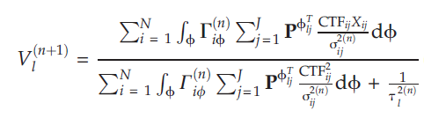
Smooth reconstruction
Instead of choosing the orientation with the maximum probability at each orientation, the back-projection operation was done in a smoothed way by weighing the back-projections according to their probabilities over all possible orientations.
The prior variance in the denominator prevented overfitting.

Slide 5
The algorithm: How it proceeds
Our initial model, is one which is reconstructed using the projections without accounting for the noise, or the correct orientations.
We then, calculate the probability of the projections for each orientation and perform a smoothed reconstruction over all possible orientations and taking the prior in account.
After reconstructing our image, we calculated a new estimate for the noise and the prior distribution. After this we again proceed to step 1.

Slide 6
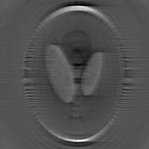
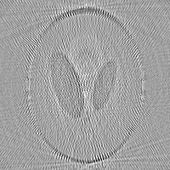
Previous Results
Last week, by not implementing a smoothed reconstruction, and by implementing back-projection and projection in the spatial space, we encountered many artifacts which resulted in reconstructions like these –

Slide 7
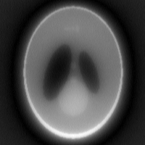
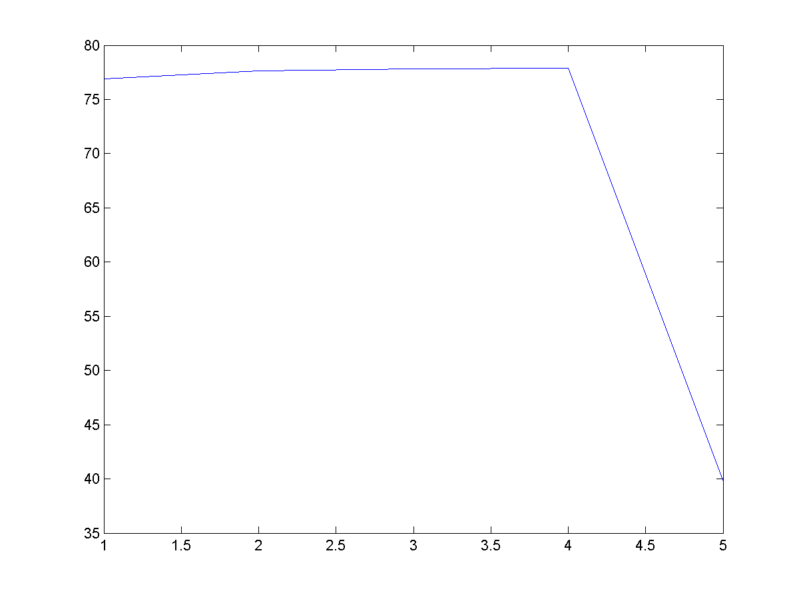

Results.. But without Interpolation
This result is without the interpolation in the back-projection.
Noise – 5% gaussian
Number of projections – 180
Error in the angles - $±1$
Number of iterations – 5
Final L2 norm error – 39.746

Slide 8
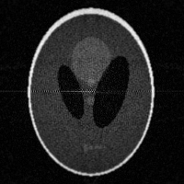
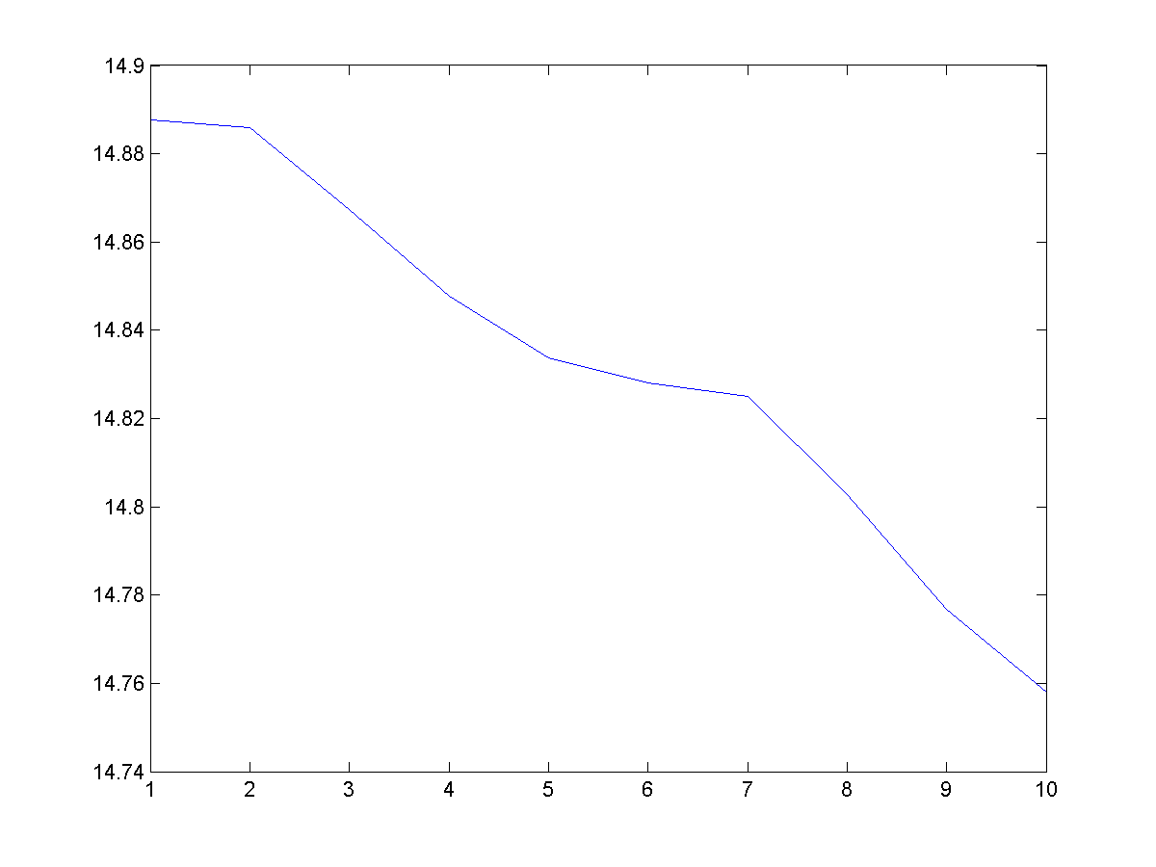
Results with interpolation.. But without error in angles
This results is with interpolation in the back-projection but the initial model has no error in the orientations.
Noise – 5% Gaussian
Number of projections – 180
Error in angles – 0
Number of iterations – 10
Final L2 norm error – 14.758

Slide 9
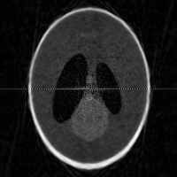
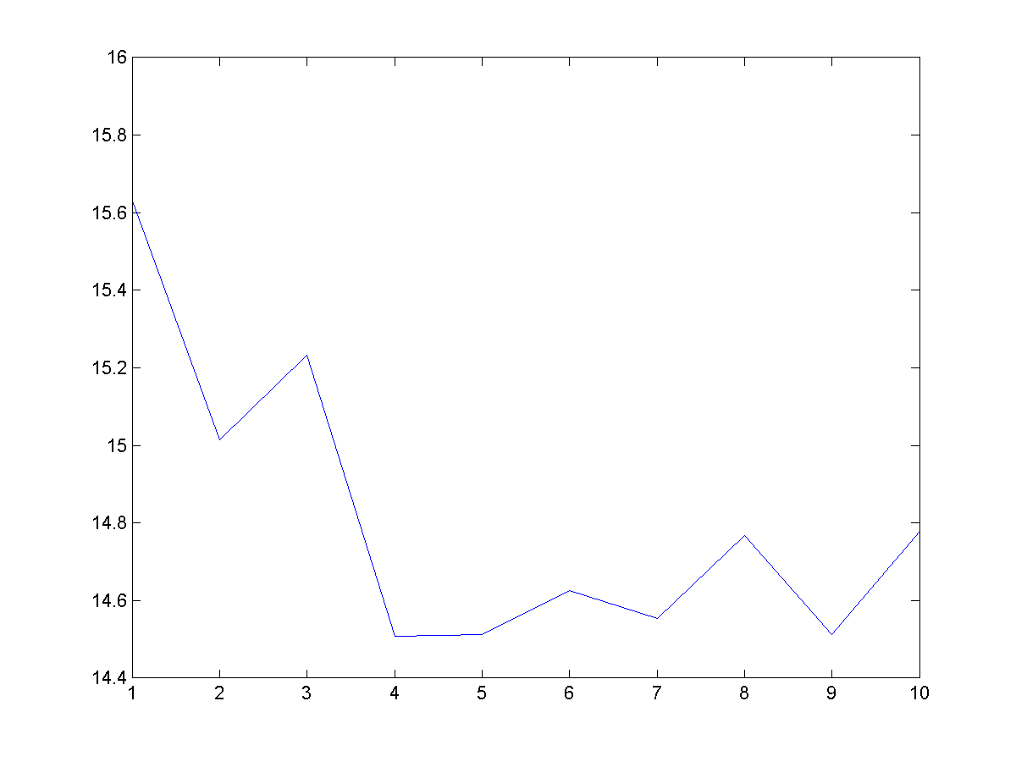

Final results
These results include the interpolation scheme in back-projections as well as error in orientation as well.
Noise – 5% Gaussian
Number of projections – 180
Error in angles - $±1$
Number of iterations – 10
Final L2 norm error – 14.779

Slide 10
Work to be done further
Incorporate shifts in the algorithm. Till now just incorrect orientations has been considered. Incorporating shifts, would be a challenge in the Fourier domain, as we need to multiply the projections by the appropriate phase difference which may lead to artifacts.
It has been noticed that, that orientations that have been incorrectly estimated in the first few iterations tend to drift off, often leading to large errors in the orientations so we need to modify the algorithm to prevent such drifts in orientation.
I have already begun work to derive the mathematics behind this approach. The formulas presented in the paper, have not been derived and in some cases just appear without any explanation. After deriving the current work, we may very well be able to modify the algorithm (for example, use a different prior) which may give better results.

